Slide 1
HORIZON 2020
Excellent Science
Global Challenges
Competitive Industries
Open to the world!

Slide 2
Structure
The EU 's Horizon 2020 programme and international cooperation
Cooperation with Russia in FP7
ERA-Net.RUS Plus: Open and upcoming calls

Slide 3
I. What is the EU's Horizon 2020 programme?
Almost €80 billion (current prices) research and innovation funding programme (2014-2020):
Investing in future jobs and growth
Addressing concerns about livelihoods, safety and environment
Strengthening the EU’s global position in research, innovation and technology
Coupling research to innovation – from research to retail, all forms of innovation
Focus on societal challenges facing EU society, e.g. health, clean energy and transport
Open for participation to all companies, universities, institutes in all EU countries and beyond

Slide 4
Three priorities
Excellent science
Industrial leadership
Societal challenges

Slide 5
Priority 1 - Excellent science
Funding (€ million, 2014-2020)
European Research Council (ERC) Frontier research by the best individual teams | 13 095
Future and Emerging Technologies Collaborative research to open new fields of innovation | 2 696
Marie Sklodowska-Curie actions (MSCA) Opportunities for training and career development | 6 162
Research infrastructures (including e-infrastructure) Ensuring access to world-class facilities | 2 488

Slide 6
Priority 2 - Industrial leadership
Funding (€ million, 2014-2020)
Leadership in enabling and industrial technologies (LEITs) (ICT, nanotechnologies, materials, biotechnology, manufacturing, space) | 13 557
Access to risk finance Leveraging private finance and venture capital for research and innovation | 2 842
Innovation in SMEs Fostering all forms of innovation in all types of SMEs | 616 + complemented by expected 20% of budget of societal challenges + LEITs and 'Access to risk finance' with strong SME focus

Slide 7
Priority 3 - Societal challenges
Funding (€ million, 2014-2020)
Health, demographic change and wellbeing | 7 472
Food security, sustainable agriculture, marine and maritime research & the Bioeconomy | 3 851
Secure, clean and efficient energy * | 5 931
Smart, green and integrated transport | 6 339
Climate action, resource efficiency and raw materials | 3 081
Inclusive and reflective societies | 1 309
Secure societies | 1 695
Science with and for society | 462
Spreading excellence and widening participation | 816
Additional funding for nuclear safety and security from the Euratom Treaty activities (2014-2018)

Slide 8
International cooperation in Horizon 2020
Most importantly:
Horizon 2020 is open to participation from across the world!
Clear ambition to substantially increase participation of international partners!
How?
General opening
Targeted international cooperation actions across Horizon 2020
Supported by horizontal international cooperation activities (in Horizon 2020 Challenge 6: follow-up to Capacities INCO programme)

Slide 9
Horizon 2020 – What is in it for Russia?
All Calls for Proposals of Horizon 2020 are fully open to Russian participation in all fields and areas.
International participation - Horizon 2020 can connect the best teams and individual researchers from Russia with Europe’s top researchers and innovators
Horizon 2020 helps to connect Russian scientists and universities with business and industry from around the world

Slide 10
Horizon 2020 – What is in it for Russia?
Horizon 2020 offers access to Europe's knowledge, access to data, access to infrastructures and access to world-leading scientific networks
Participation in Horizon 2020 provides opportunities to market one's ideas, know-how and technologies internationally
Russian scientists can be funded in the Marie Sklodowska Curie mobility programme and by the European Research Council (ERC)

Slide 11
Horizon 2020 Work Programme 2014-15: Open opportunities
All research calls are open for Russian project partners.
Horizon 2020 first calls were published on 11 December 2013.
Please read the Work Programmes of the calls.
Please apply as project participant in a research consortium,
- or for a mobility grant to the Marie Skłodowska-Curie programme,
- or a grant from the European Research Council.

Slide 12
Horizon 2020 currently open calls in the area of "Health, demographic change and wellbeing":
Three calls on 'Personalising health and care', deadlines
15/04/2014
14/10/2014
21/04/2015
Two calls on 'Health Co-ordination activities', deadlines
15/04/2014
21/04/2015

Slide 13
H2020 call for expression of interest for experts
Join the database of independent experts for European research and innovation.
The European Commission appoints independent experts to assist with research and innovation assignments including the evaluation of proposals, monitoring of projects, and evaluation of programmes, and design of policy.
Register online at: http://ec.europa.eu/research/participants/portal/desktop/en/experts/index.html

Slide 14
Useful newsletters
S&T Gate RUS.EU Newsletter:
http://www.st-gaterus.eu/en/543.php
Russian NCP "Biotechnology" Newsletter:
http://fp7-bio.ru/biotech/infoletters/
Russian NCP "Research Infrastructures" Newsletter:
http://fp7-infra.misis.ru/newsletters/
Russian NCP "Mobility" Newsletter:
http://fp7.hse.ru/mobility/bull
Voronezh Regional Information Centre for Scientific and Technological Cooperation with EU
http://www.ric.vsu.ru/ru/news/information_bulletin

Slide 15
Useful links
Horizon 2020 official webpage: http://ec.europa.eu/programmes/horizon2020/
Participant Portal: http://ec.europa.eu/research/participants/portal/
European Commission – Research & Innovation:
http://ec.europa.eu/research/index.cfm
Delegation of the European Union to the Russian Federation:
http://www.EUinRussia.ru
EU-Russia Year of Science 2014:
http://eu-russia-yearofscience.eu
http://godnauki-rossiya-ec.ru

Slide 16
Gate2RuBIN project
The “Gate to Russian Business and Innovation Networks” project is aimed to assist to the development of business and technological co-operation between SMEs and R&D organisations of Russia and European Union, contributing to their competitiveness capacities.
The project consortium operates the Enterprise Europe Network Correspondence Centre in Russia.
The project provides 3 types of services:
Information, feedback, business co-operation and internationalisation;
Innovation, technology and knowledge transfer;
Encouraging the participation of SMEs in the EU's Framework Programme.
Link: http://www.gate2rubin.ru/

Slide 17
II. Participation in FP7: key figures (*)
RUSSIAN FEDERATION
FP7 Collaboration Projects: 298
Russian Participations: 486
EU Contribution: 66,460,461 €
Applicants Success Rate: 22.85%
(*) Excluding People and Ideas Specific Programmes

Slide 18
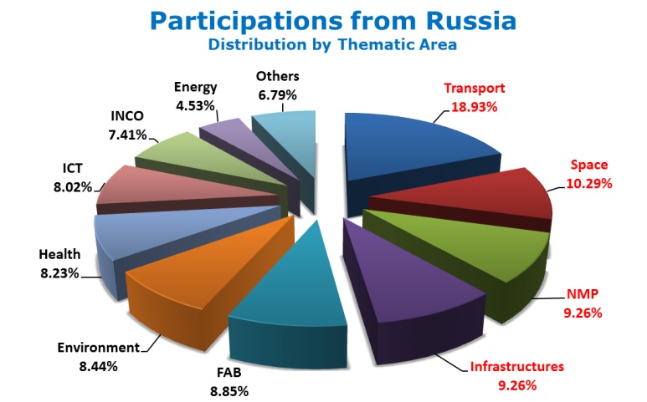
Participation in FP7: key figures (2)*
*Excluding People and Ideas Specific Programmes

Slide 19
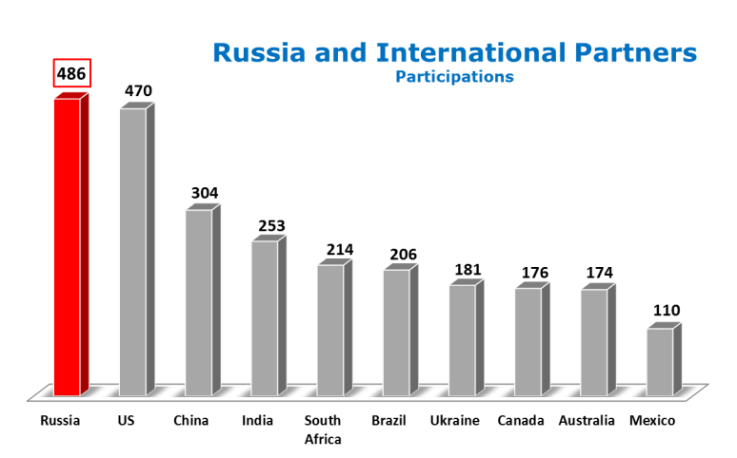
Participation in FP7: key figures (3)*
*Excluding People and Ideas Specific Programmes

Slide 20
Participation in FP7: success stories
OPENAIR – Optimisation for low Environmental Noise impact AIRcraft
Project Coordinator: SNECMA SA (France)
Russian Partners:
Joint Institute for High Temperatures – RAS
Andreyev Acoustics Institute
The Central Aerohydrodynamic Institute named after Prof. N.E. Zhukovsky
Project EU Contribution: € 18,273,829
Research Field: Aerospace Technology – Environmental Protection
DIABIMMUNE – Pathogenesis of type 1 Diabetes – Testing the hygiene hypothesis
Project Coordinator: Helsingin Yliopisto (Finland)
Russian Partners:
Ministry of Health & Social Development (Karelian Republic of the Russian Fed.)
Petrozavodsk State University
Project EU Contribution: € 5,999,900
Research Field: Biotechnology – Life Sciences – Medicine - Health

Slide 21
III. ERA.Net RUS Plus initiative (2013-2018)

Slide 22
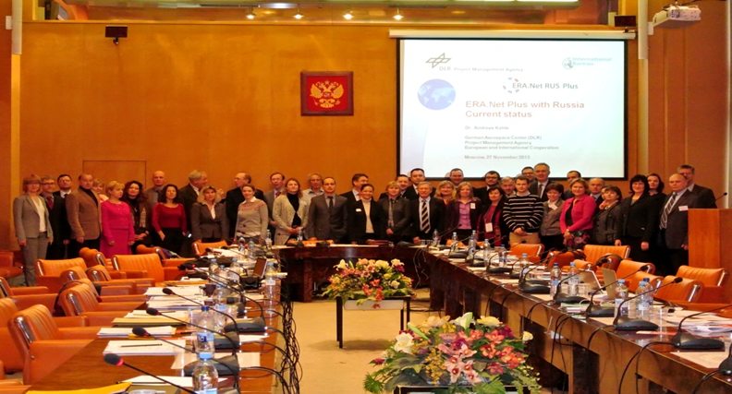
ERA.Net RUS Plus
Joint funding mechanism and coordinated programs
Kick-off meeting at MON
27 November 2013
Moscow
Duration: November 2013 – October 2018
Partners: 27 from 15 countries (currently)
Joint Calls: 1x Innovation, 1x S&T
Indicative up to 25 Mio. €
Call Budget:

Slide 23
Partners (1)
Facilitators:
German Aerospace Center, Project Management Agency, DLR (Germany)
National Centre for Scientific Research, CNRS (France)
3. Centre for Social Innovation, ZSI (Austria)
4. National Research University – Higher School of Economics, HSE (Russia)
EU/AC programme owners (funding parties) (in green: funding parties in the Call for innovation projects):
Academy of Finland, AKA (Finland)
Ministry of Higher Education and Research, MESR (France)
Institute for Agricultural Research, INRA (France)
Federal Ministry of Education and Research, BMBF (Germany)
Federation of Industrial Research Associations - AiF Projekt GmbH (Germany)
The Israel Industry Center for R&D, MOITAL (Israel)
Latvian Academy of Sciences, LZA (Latvia)
The National Centre for Research and Development, NCBR (Poland)
Exec. Agency for Higher Education, Research, Development, Innovation, UEFISCDI (Romania)
Slovak Academy of Sciences, SAS (Slovakia)
Swiss National Science Foundation, SNF (Switzerland)

Slide 24
Partners (2)
Center of International Projects of the Academy of Sciences of Moldova (Moldova)
Scientific and Technological Research Council of Turkey, TUBITAK (Turkey)
Estonian Research Council, ETAg (Estonia)
General Secretariat for Research and Technology, GSRT (Greece)
The Austrian Research Promotion Agency, FFG (Austria)
Embassy of France in the Russian Federation, AMBAFRAN (France)
Fondazione Sapienza, University of Rome (Italy, tbc)
Russian programme owners (funding parties) (in green: funding parties in the Call for innovation projects):
Russian Foundation for Basic Research, RFBR
Russian Foundation for Humanities, RFH
Ural Branch of the Russian Academy of Sciences, UB RAS
Far Eastern Branch of the Russian Academy of Sciences, FEB RAS
Siberian Branch of the Russian Academy of Sciences, SB RAS (Russia, tbc)
Ministry of Education and Science of the Russian Federation, MON (Russia, tbc)
Russian Foundation for Assistance to Small Innovative Enterprises, FASIE

Slide 25
Joint Call Structure
Two funding lines
1) S&T
Nanotechnologies
Environment/Climate Change
Health
Social Sciences and Humanities
2) Innovation
Thematically open
Launch expected by May
Call opened 31 March 2014
Call closes on 28 May 2014
17:00 CET (19:00 MOW )

Slide 26
Funding Parties
S&T funding line:
Estonia, Finland, France, Germany, Latvia, Moldova, Poland, Romania, Russia, Slovakia, Switzerland, Turkey
Innovation funding line:
Austria, Germany, Greece, Israel, Poland, Romania, Russia, Turkey
Funding Parties are welcome to join until call publication!

Slide 27
Call Topics / Sub-topics (Based on EU-Russian expert Workshops)
Nanotechnologies
Advanced nano-sensors for environment and health
Novel functional nanomaterials based on design and modelling
Nanomaterials for efficient lighting
Environment/Climate Change
Increasing the reliability of regional climate projections: models and measurement
Environmental impact and risk of raw materials extraction and transportation
Extreme climate events and their impact on the environment

Slide 28
Call Topics / Sub-topics (Based on EU-Russian expert Workshops)
Health
Molecular Mechanisms of Brain Function and Pathology
Regenerative Medicine and Biomaterials
Drug Discovery for Cancer, Cardiovascular and Infectious Diseases
Understanding Conflict, Identity, and Memory: Past and Present
Demographic Change, Migration and Migrants
Opportunities for and Challenges to Regional Development and Social Cohesion
Innovation
Thematically open
Social Sciences and the Humanities

Slide 29
Framework conditions
Virtual Common Pot: Each Funding Party funds its own teams within a multilateral project
Eligible Applicants
Research and higher education entities
Research performing small and medium enterprises (SME)
Other entities eligible for funding according to national legislation
Target Group: - Consortia with partners from at least three different countries (one from Russia)
International, independed, expert-based evaluation of the proposals
Joint Decision taking by the Funding Parties
Duration of projects to be funded: up to 30 months

Slide 30
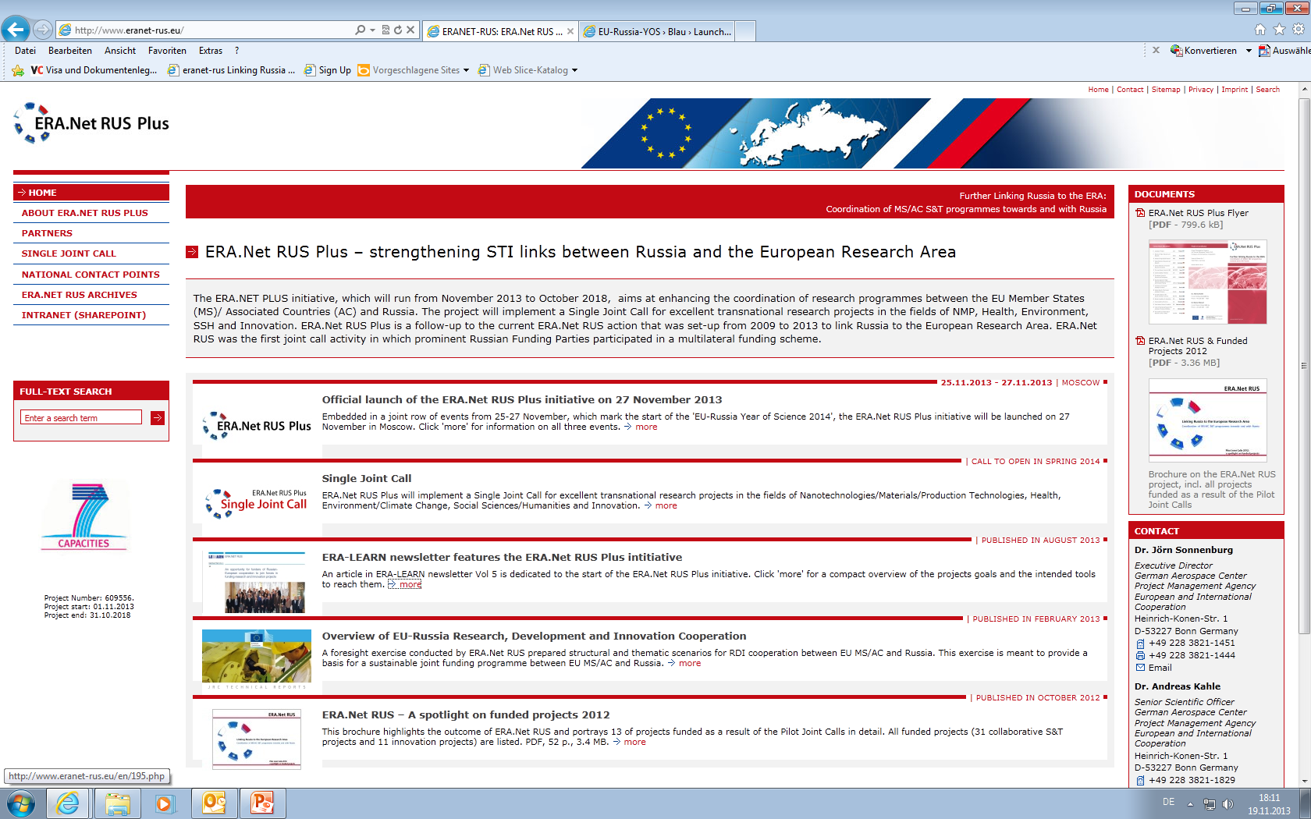
Call Publication on www.eranet-rus.eu
Coming Soon:
May/June 2014

Slide 31
Thank you for your attention!

